Slide 1

Drought Planning and Response
Linwood Peele
Water Supply Planning Section
NCDENR - Division of Water Resources
N.C. Drought Management Advisory Council
Annual Meeting
March 24, 2011 Raleigh, NC

Slide 2
Drought Planning and Response
Presentation will cover:
Why is Drought Planning Important?
NC’s Role & Mechanisms for Drought Planning and Response
NC’s Latest Provisions
Water Shortage Response Plan Update
Notes:
Effective WSRPs

Slide 3
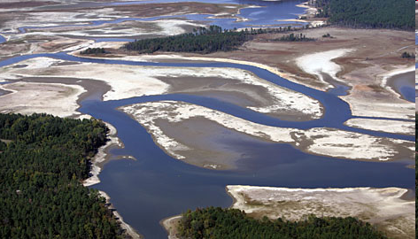
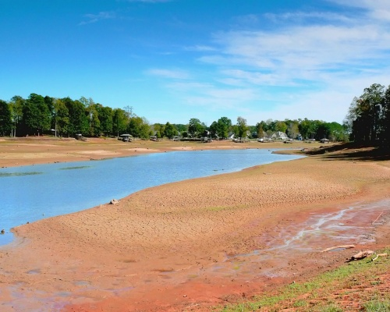
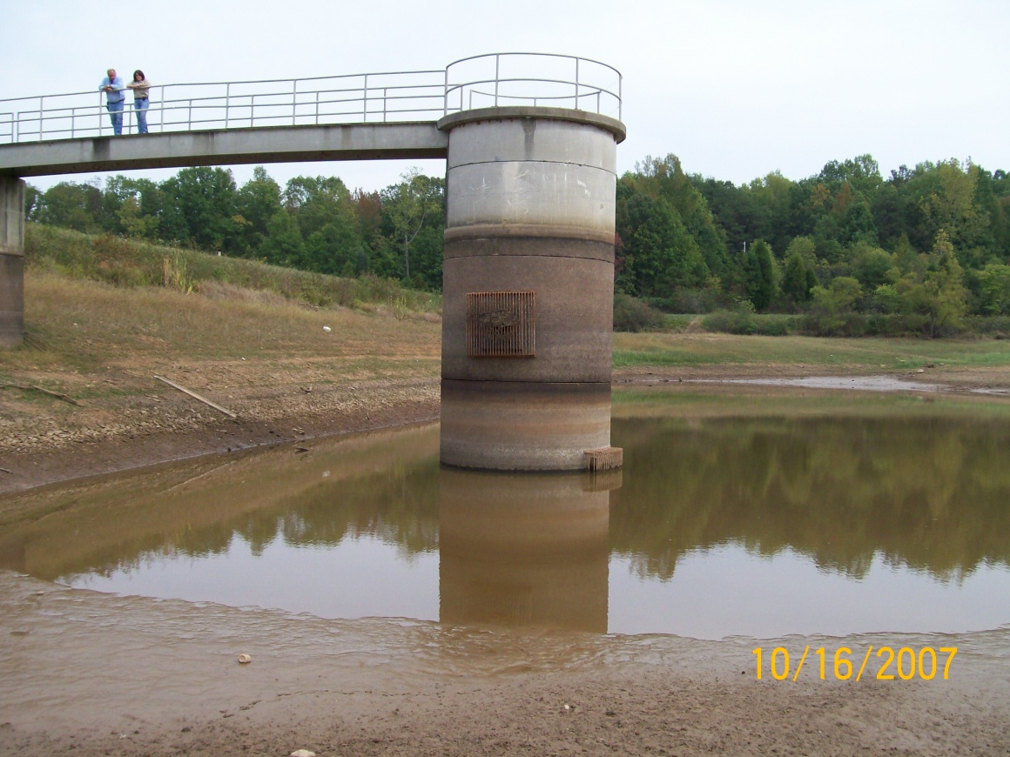
Why is Drought Planning Important?
Notes:
To avoid situations like the photos conveying above.
Top left – 2002 Cleveland County Water SD using a fire truck to pump water from one hydrant to the Town of Shelby’s hydrant. 1st Broad River, then have an emergency intake on Broad River. Top right – 2007 Falls Lake (Approximately 9 feet down and about 30% of capacity), it filled on April 8, 2008.
Bottom left – 2007 Rocky Mount Reservoir Bottom right – Monroe’s Lake Twitty 10/2007

Slide 4
NC’s Role & Mechanisms
Local Water Supply Planning
  2003: In response to a multi-year drought culminating in 2002, the General Assembly passes Session Law 2003-387 (HB 1062)
    Requires all LWSPs to prepare a Water Shortage Response Plan (WSRP), describing how water systems will respond to drought and other water shortage emergencies while continuing to meet essential public water supply needs.

Slide 5
NC’s Role & Mechanisms
2002: General Assembly passed Session Law 2002-167 (HB1215)
  Required the Environmental Management Commission to develop and implement rules governing water conservation and water reuse during drought and other water emergency situations for the following water users:
    Publicly and privately owned water supply systems
    State agencies
    Local governments
    Business and industrial users
    Agricultural and horticultural users

Slide 6
NC’s Role & Mechanisms
2007: Adopted. 15A NCAC 02E 0600 – Water Use During Drought Rules
  Water use reduction reporting during drought
  Water shortage response planning requirements
  Default water use reduction measures for community water systems failing to meet planning requirements

Slide 7
Water Use Reduction Reporting During Drought
15A NCAC 02E.0605 (1)
    Requires publicly and privately owned water systems to report the implementation of mandatory water conservation measures to DENR within 72 hours of their initial enactment.
    Enhanced online water conservation reporting website at http://www.ncwater.org/Drought_Monitoring/ reduction/
Notes:
We will ask all water system to update their water conservation status even if it is not restricted.
Use this information to develop coordination strategies.

Slide 8
Water Shortage Response Planning Requirements
Rule 15A NCAC 02E.0607 (a)
    Plan shall include:
    Position or Organization Unit of Responsibility
    Notification Procedures
    Tiered Level of Responses to Reduce Water Use
    Triggers to Initiate Responses
    Compliance (Enforcement) Procedures
    Affected Party Review and Comment Procedures
    Variance Procedures
    WSRP Evaluation Method
    Revising and Updating WSRP Procedures

Slide 9
Default Water Shortage Response Planning Measures
Rule 15A NCAC 02E.0612
    Requires publicly and privately owned water systems that are required to prepare a LWSP that fail to prepare a written WSRP, shall implement the default water use reduction measures of Rule .0613 or .0614

Slide 10
NC’s Latest Provisions
Latest Initiatives for Drought Response
Drought Legislation (Session Law 2008-143)
  Responding to the 2007/2008 drought the General Assembly passes HB 2499
    DENR approval of WSRPs
    Mandatory implementation of WSRP
Notes:
The most robust drought legislation to date…

Slide 11
DENR Plan Approval
Water Shortage Response Plans must contain:
  Tiered levels of conservation based on severity
  Each tier results in more stringent conservation
  Provisions must meet requirements in the Drought Rules – 15A NCAC 02E .0600
  Can not meter/regulate private drinking wells
Notes:
As a water system reaches a trigger, the level of conservation has to reflect that level of severity
Can not meter/regulate private drinking wells (3 different place in the drought legislation)

Slide 12
Mandatory Actions & Reporting
No approved WSRP in D3 or D4 required to implement default measures in 15A NCAC 02E .0600 within 10 days
Implement WSRP measures within 10 days of reaching triggers
Report implementation of WSRP measures to DENR within 72 hours
Weekly reporting of water use during extreme (D3) and exceptional (D4) drought

Slide 13
Enhanced Enforcement Measures
Civil Penalties
  Any Person for failure to report water use when required under 143-355(k) (D3 and D4 plus) or to comply with emergency orders
    $100 - $500 per day
  Local Government for failure to implement required water conservation measures.
    Up to $10,000 per month

Slide 14
WSRPs Update
Water Systems required to submit WSRP:
  550 Water systems
  542 Water systems submitted WSRP to date
  42 Current under review
  8 Have not submitted a WSRP for review
  508 Approved (Meets minimum criteria)

Slide 15
WSRPs Next Step
Water Shortage Response Plans will be incorporated in the River Basin Hydrologic Models
  Evaluate the effectiveness of triggers in WSRPs
  Quantify the potential reductions in demand when WSRPs are implemented
  Indicate whether WSRPs are adequate to address the magnitude and duration of water supply shortages identified in modeling results
  Provide guidance with WSRP revisions
Notes:
Using established triggers would allow the WSRPs to be model to determine the impact of the conservation measures of their water sources

Slide 16

Questions?
Contact: Linwood Peele
Water Supply Planning Section
Division of Water Resources
Phone: (919) 715-5455
Email: Linwood.Peele@ncdenr.gov

